Slide 1
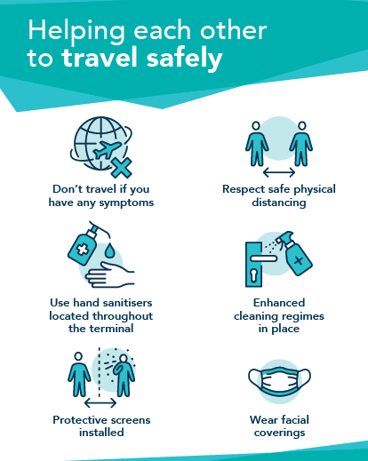
Access ABZ Forum
Update – February 2021

Slide 2
Agenda
Total Passenger Number and Total PRM’s (passenger with reduced mobility) YTD
Monthly breakdown of PRM’s
Breakdown of PRM passengers by airline and Pre-notification rates.
Breakdown of types of assistance requested.
The current situation….
Travel Safely Measures
Clear Signage/Instruction, Enhanced Cleaning, Perspex Screens, Control of Passenger Flow/Website
Face Coverings/Exemptions
6. Introduction to ABM – the new Assistance provider
7. Airport Accessibility Report 2019/20
8. Future Journeys Observatory – Andy Hyde
9. Updates and Discussion

Slide 3
Total Passenger Numbers & Total PRM’s YTD
 | 2020 | 2019 | Difference | Difference %
Total Pax | 641,442 | 2,386,401 | 1,744,959 | -73%
Total PRM | 5386 | 21261 | 15875 | -75%

Slide 4
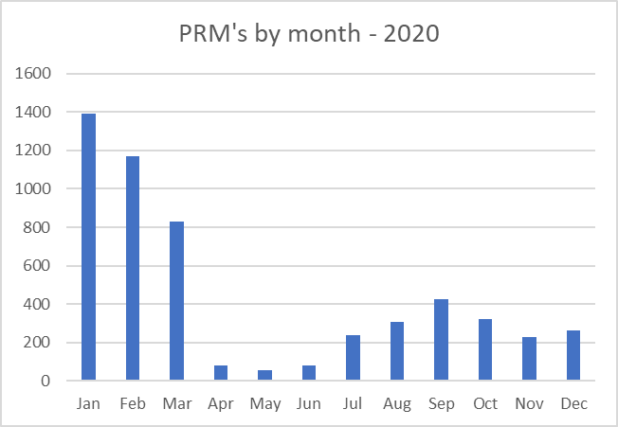
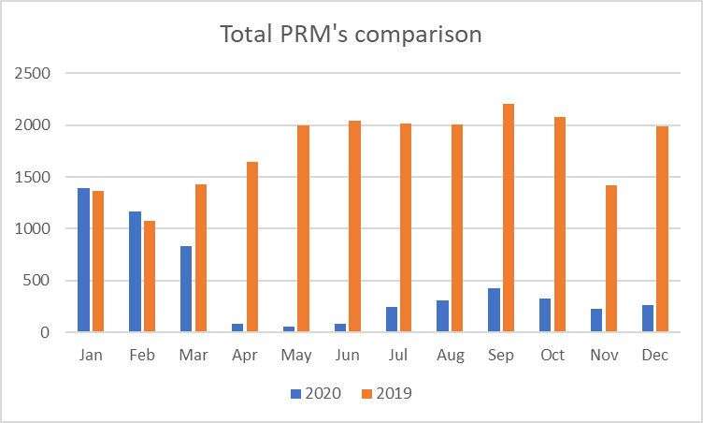
Monthly breakdown of PRM’S in 2019 and 2020.
Notes:
3,000 more PRM passengers than last year YTD. From April significant increase in numbers compared with last year, partly down to recording system – Able2fly in use. Peak months May to September. From April pre-notification rates dropped , sit average 79.6% compared with 88% in 2018.

Slide 5
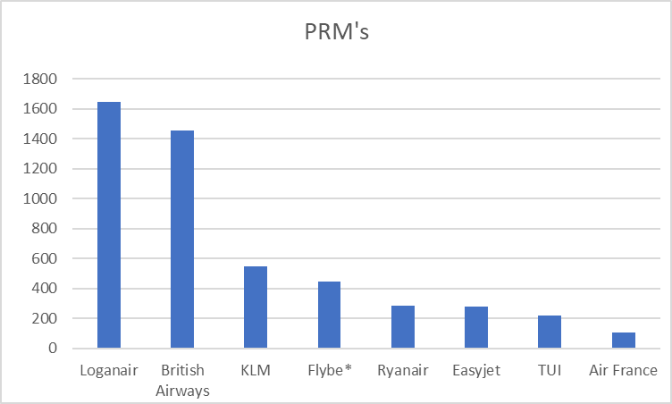
Breakdown of PRM’s per airline - 2020
Airline | PRM's
Loganair | 1648
British Airways | 1454
KLM | 550
Flybe* | 447
Ryanair | 286
Easyjet | 280
TUI | 220
Air France | 105
*Flybe ceased flying early March
Pre-notification of PRM’s
Total Number of passengers pre-notified = 3998
71% of all passengers pre-notified.

Slide 6
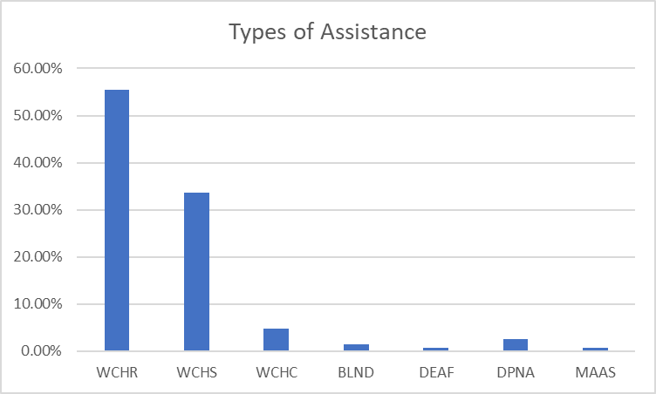
Breakdown of types of assistance requested/provided
Assistance Requested | %
WCHR | 55.4%
WCHS | 33.7%
WCHC | 4.79%
BLND | 1.5%
DEAF | 0.7%
DPNA | 2.5%
MAAS | 0.8%
WCHR – (wheelchair) passenger can walk short distance and up or down stairs
WCHS – (wheelchair) passenger can walk short distance but can’t manage stairs
WCHC – (wheelchair) passenger can not walk any distance and will require aisle chair to be seated
BLND – passenger is blind or has reduced vision
DEAF – passenger is deaf or hard of hearing
DPNA – passenger with intellectual or developmental disability
MAAS – meet and assist.

Slide 7
The current situation….
Lockdowns, Quarantine, Travel Corridors, Tiers, PCR Tests, Antigen Tests, advice against all non essential travel…..
Flights currently to Heathrow, Manchester, Norwich, Kirkwall, Sumburgh, Bergen, Stavanger and Humberside.
Wizz Air to Gdansk – start of summer season (end of March)
TUI – end of February currently
Easyjet - Geneva not operating until Feb half term and LTN continues to be suspended until 5th March
Easyjet to Gatwick returns on 2nd May
Ryanair to Alicante, Malaga and Faro end of March.
Air France – start of summer season, end of March
Retail – Just WH Smith and Boots open in the departure lounge.

Slide 8
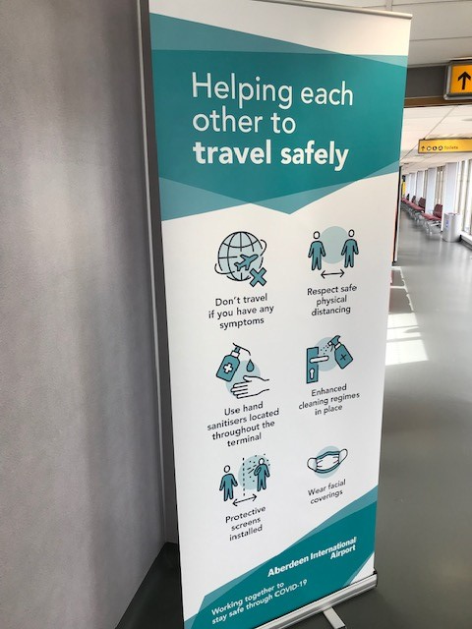
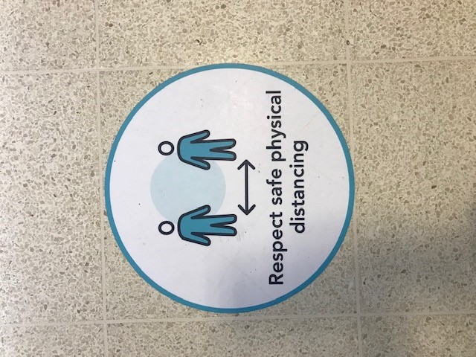
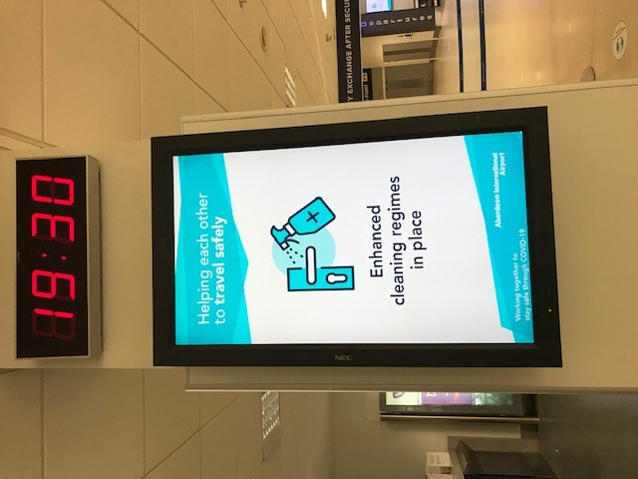
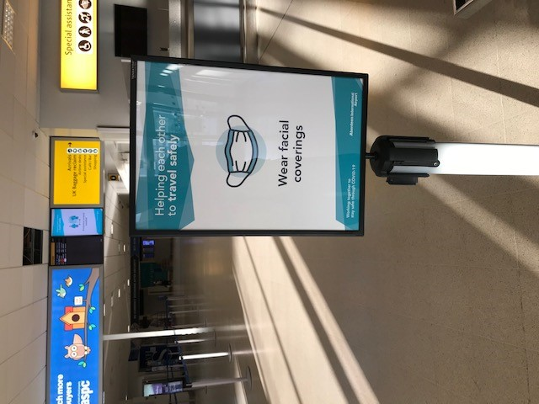
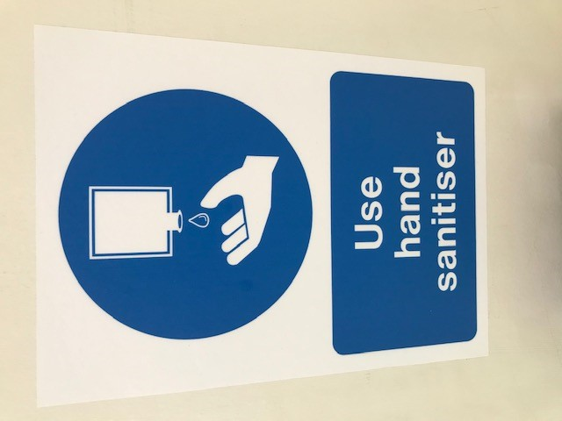
Travel Safely measures introduced
Floor markers for physical distancing
Use of Digital screens for messaging
Loudspeaker announcement played every 30 minutes throughout the terminal reminding passengers of safety measures.

Slide 9
Enhanced Cleaning – Use of Anti-microbial technology
We are now using an application called Zoono which provides an antimicrobial protection that is effective against a wide range of bacteria, viruses and pathogens.
Our cleaning team have been trained to use this by use of a spray as well as wiping down surfaces.
It stays active for extended periods of time providing protection on surfaces.
The team apply the product in all areas and they start the process all over again when they are complete.

Slide 10
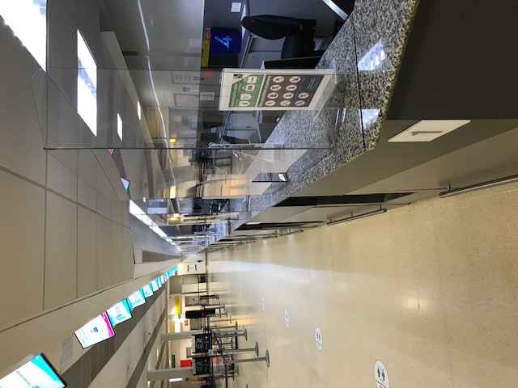
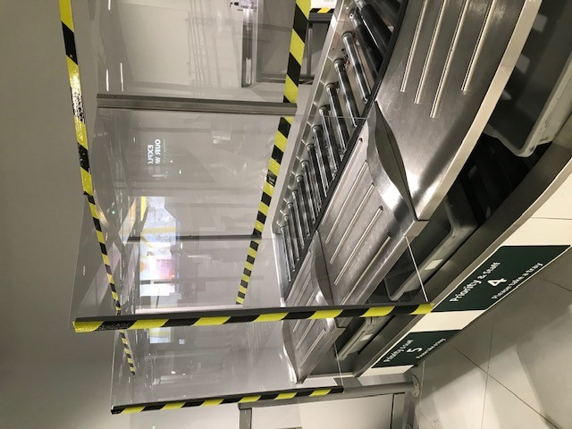
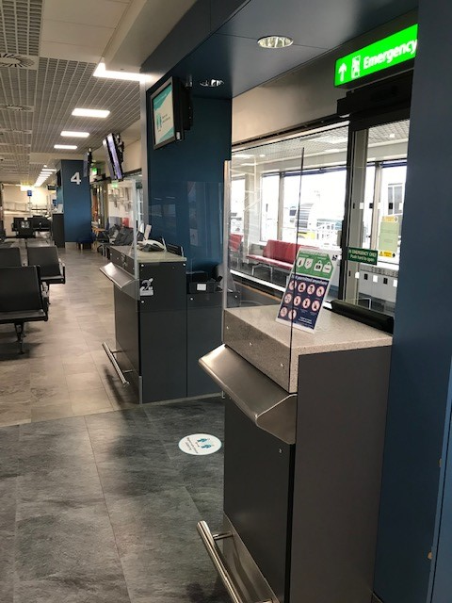
Perspex screens at all customer interface points
Assistance Desk
Check In
Security Search
Departure Gates
The clear Perspex screens provide protection against the spread of the virus for our staff and for passengers.
Other measures:
Controlled passenger flow – e.g. one way systems, dividing up corridors.
Pre-registering before travelling.
Dedicated section on website

Slide 11
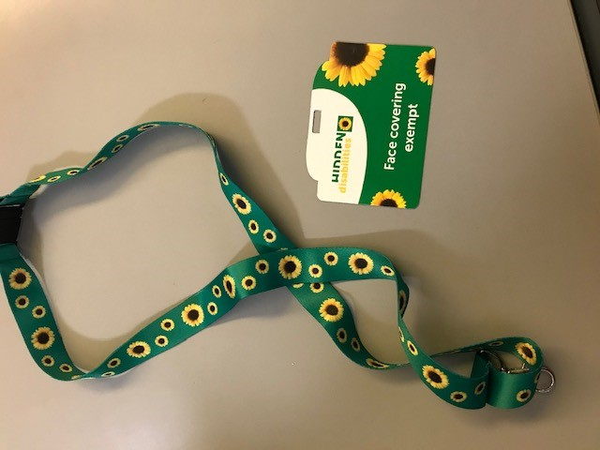
Face Coverings and Exemptions
Under Scottish Government legislation face coverings are required to be worn in the Terminal Building and on flights.
However, we understand some people are exempt from this requirement.
To help with this we are able to supply any passenger with a face covering exempt card that can be attached to a lanyard. Our team will also recognise other cards/means of highlighting an exemption.
As per the picture we now are using the Sunflower Lanyard which brings us in line with the majority of airports and various other places throughout the UK, simplifying the process for passengers with hidden disabilities.

Slide 12
Face Coverings/Face shields
We expect our team members to politely remind anyone not wearing a face covering of the requirement to do so.
Equally our teams have been fully briefed that there are a variety of reasons why someone might not be able to wear a face covering.
If a passenger relies on lip reading or needs any member of staff to remove their face covering temporarily to help communicate then they just need to let them know.
Scottish Government guidance on Face shields : they may be used, but only if they are worn in addition to a face covering underneath, as the evidence shows that they do not provide adequate protection.
If a passenger is unable to wear a face covering, a face visor or face shield can be worn as it does provide a limited level of protection.

Slide 13
Change of Assistance provider
On the 1st February ABM became the Passenger Assistance provider at Aberdeen Airport, taking over from G4S.
ABM employ over 140,000 people worldwide and 6,000 people in the UK across various industries.
In aviation, ABM provide cleaning services, passenger services and aircraft services.
ABM are already established at Aberdeen Airport as they manage the cleaning contract and they provide passenger assistance at other UK airports including Edinburgh.

Slide 14
Airport Accessibility Report 2019/20
The CAA’s fifth annual review of accessibility at UK airports covered the period between 1st April 2019 and 31st March 2020.
The report was published in November (delay in publishing due to Covid)
Aberdeen was ranked as ‘needs improvement’ but this was not a reflection of the service or the feedback provided by our passengers.
The ranking was due to not being able to provide ‘robust and complete data’ as we experienced challenges with our new system at the time for collecting performance data between April and October 2019.
Positively, the CAA have noted in the report that since November 2019, ‘the data collection issues have been resolved and the

Slide 15
Airport Accessibility Report 2019/20
(cont’d) waiting time standards have been comfortably met for all subsequent months. We also note that responses to the CAA passenger survey on the quality of assistance provided to disabled and less mobile passengers have been generally positive’
We are disappointed that this ranking does not reflect all of the good work done by the assistance team and the investment made in the service but we are determined to re-attain our ‘very good’ status as soon as possible.

Slide 16
Future Journeys Observatory – Andy Hyde

Slide 17
Update & Discussion

