Slide 1
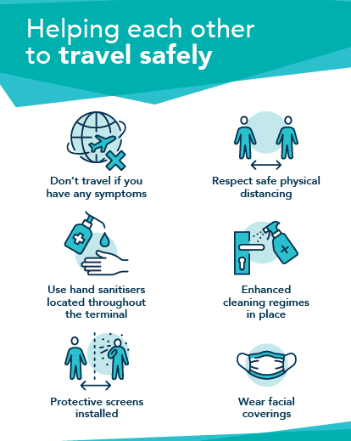

Access ABZ Forum
Update – February 2021

Slide 2
Agenda
Introductions
Summary of passenger numbers YTD and PRM totals
Breakdown of PRM passengers data
Overview of current situation
Updates
ABM (assistance provider) updates
CAA update
Members updates

Slide 3
Total Passenger Numbers & Total PRM’s YTD
 | 2021 YTD (Jan-Mar) | 2020 (Jan-Mar) | Difference | Difference %
Total Pax | 61,662 | 398,687 | -337,025 | -85%
Total PRM | 521 | 3390 | 2869 | -85%

Slide 4
Monthly breakdown of PRM’S in 2021.
 | 2020 | 2021
January | 1391 | 172
February | 1168 | 126
March | 831 | 223
85% reduction in number of PRM passengers assisted YTD compared with 2020.
Notes:
3,000 more PRM passengers than last year YTD. From April significant increase in numbers compared with last year, partly down to recording system – Able2fly in use. Peak months May to September. From April pre-notification rates dropped , sit average 79.6% compared with 88% in 2018.

Slide 5
Breakdown of PRM’s per airline - 2020
*KLM resumed flights from 15th March
Pre-notification of PRM’s
65% of PRM passengers assisted have been pre-notified YTD in 2021.

Slide 6
Breakdown of types of assistance requested/provided
Assistance Requested | %
WCHR | 54%
WCHS | 34%
WCHC | 6%
BLND | 0.4%
DEAF | 0.5%
DPNA | 3%
WCMP | 2%
WCHR – (wheelchair) passenger can walk short distance and up or down stairs
WCHS – (wheelchair) passenger can walk short distance but can’t manage stairs
WCHC – (wheelchair) passenger can not walk any distance and will require aisle chair to be seated
BLND – passenger is blind or has reduced vision
DEAF – passenger is deaf or hard of hearing
DPNA – passenger with intellectual or developmental disability
WCMP – passenger travelling with manual wheelchair

Slide 7
The current situation….
Still a great deal of uncertainty regarding flight schedules and international travel in particular.
TUI, Ryanair, Wizz Air have pushed back their restart dates and are now showing May into June.
Non essential travel within the UK is now allowed but it is unclear as to when and how International travel will resume in Scotland. In England the 17th May is the date earmarked for the restart of International travel.
KLM restarted flights to AMS on the 15th March after the UK travel ban was lifted but Air France announced they would not be operating from Aberdeen this summer or next Winter.
Easyjet London Gatwick flights start on the 1st May (3 times weekly)
COVID testing is available at the airport and on the 27th April moved into the former Joe’s Coffeehouse situated opposite the entrance to Security.
World Duty Free and the airside restaurant,The Distilling House have just reopened to add to Boots and WH Smith within the departure lounge.
The WH Smiths landside arrival store (close to the Granite City) will reopen on 6th May.
Unfortunately, Dixons Travel have announced the closure of all of their airport stores.
People being encouraged to take a COVID test before visiting Scottish Islands on holidays (not compulsory)
COVID passports, use of NHS app…..

Slide 8
Updates
‘Keep Safe’ initiative - refresh
Website pages (Passenger assistance/Covid) have been further updated with more questions answered and easier to navigate
Putting together a survey for Access Forum members to understand specific needs and requirements.
Taxi-way project between 24th May and 25th June which will require the temporary closure of the NHS Patients Lounge and toilets – Island flights will be via the main departure lounge.
Email us for confidence (ABM)
Innovation meeting – outputs e.g. Airside Reception desk? Signcode? Webinars? (ABM)

Slide 9

Since the contract commenced on the1st February we have trained all our workforce in disability awareness, hidden disabilities, health and safety and customer service.
We have invested in new equipment for an improved passenger experience. This includes the S-MAX chair, Staxi wheelchair and the Pro Move sling. Please see video below on the pro move sling:
https://youtu.be/nSTSq_1wVT0
We have our staff trained on enhanced cleaning to ensure all our areas and equipment are cleaned regularly. We also want to ensure both our staff and passengers feel safe at all times with the correct PPE and correct disinfection/sanitisation procedures in place.
ABM have introduced a voluntary vaccine registration and lateral flow testing for our staff
We continue to collaborate with the airport to provide the latest best practises available for our passengers.

Slide 10

CAA latest communication
Advising airports that they will continue to alleviate PRM quality standards until at least 17th May;
Suspension of requirement to survey PRM passengers, suspension of obligation to consult with disability groups (although they encourage some communication to be maintained)
Departing passengers – some relaxation of standards
Arriving passengers – existing standards remain.
CAA won’t be publishing a report ranking airports in 2021.

Slide 11









Update & Discussion

