Slide 1
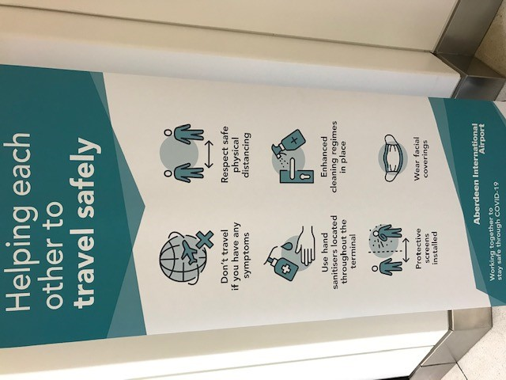
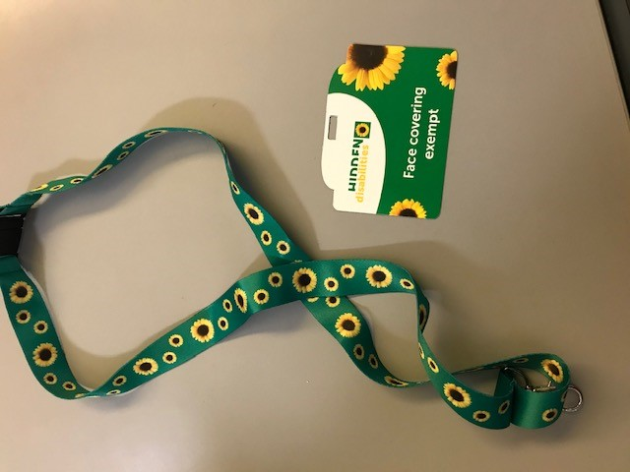

Access ABZ Forum
Update – August 2020

Slide 2
Agenda
Total Passenger Number and Total PRM’s YTD
Monthly breakdown of PRM’s and Prenotifications
Summary of PRM passengers
Breakdown of types of assistance.
Travel Safely Measures
Clear Signage/Instruction, Enhanced Cleaning, Perspex Screens, Control of Passenger Flow, Website
Face Coverings/Exemptions
Live Transcribe App
6. NHS Patient Lounge
7. Flight Schedule
8. Retail
9. Access Forum Involvement

Slide 3
Total Passenger Numbers & Total PRM’s YTD
 | 2020 | 2019 | Difference | Difference %
Total Pax YTD (31st July) | 471,503 | 1,389,640 | -918,137 | -66%
Total PRM YTD (31st July) | 3845 | 11754 | -7909 | -67%

Slide 4

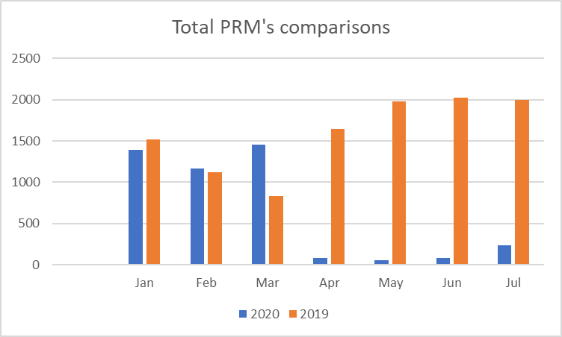
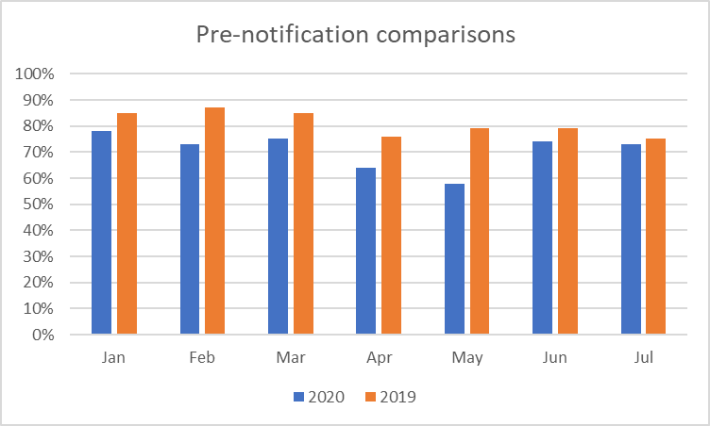
Monthly breakdown of PRM’S and prenotifications.
Notes:
3,000 more PRM passengers than last year YTD. From April significant increase in numbers compared with last year, partly down to recording system – Able2fly in use. Peak months May to September. From April pre-notification rates dropped , sit average 79.6% compared with 88% in 2018.

Slide 5
Summary of PRM passengers.
‘Lockdown’ officially announced on 23rd March 2020
Total of 3,390 PRM passengers had been assisted up until the end of March.
From April until the end of July 455 PRM’s were assisted through the airport.
YTD total of 3845 PRM’s which is 67% less than the YTD total in 2019.
The airport remained open throughout the lockdown period supporting vital links with the Highland and Islands and maintaining a limited number of routes primarily to facilitate the transport of essential workers.

Slide 6
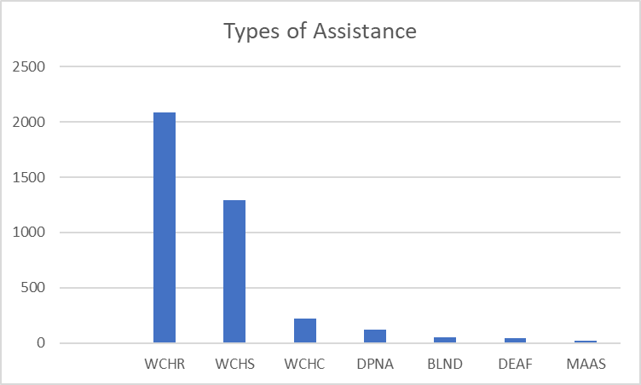
PRM – Breakdown of types of assistance YTD
CLASSIFICATION | Number | %
WCHR | 2082 | 54%
WCHS | 1293 | 34%
WCHC | 222 | 6%
DPNA | 124 | 3%
BLND | 51 | 1%
DEAF | 40 | <1%
MAAS | 20 | <1%
Notes:
WCHR 59%, WCHS 30%, WCHC 5%, BLND 1.5%, DEAF 1.0%, DPNA 3%, MAAS 1%

Slide 7

Travel Safely Measures Introduced
The airport has made a significant investment towards ensuring the safety and wellbeing of our passengers and staff in line with all UK and Scottish Government guidance.
We remain in regular contact with the relevant health authorities with regards to the latest developments on Coronavirus (Covid-19)
We have introduced a series of measures to ensure our travellers enjoy a safe and pleasant experience while passing through the terminal.
We recognise that this unprecedented situation can cause anxiety and uncertainty, in particular for passengers who are classed as higher risk and by letting people know about the measures we have taken we hope that we can provide some reassurance.
Notes:
April to September – struggled to meet passengers within 5 and 10 minute SLA’s for both pre-booked and non pre-booked

Slide 8
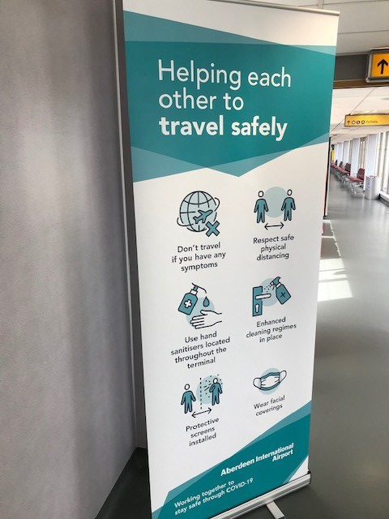
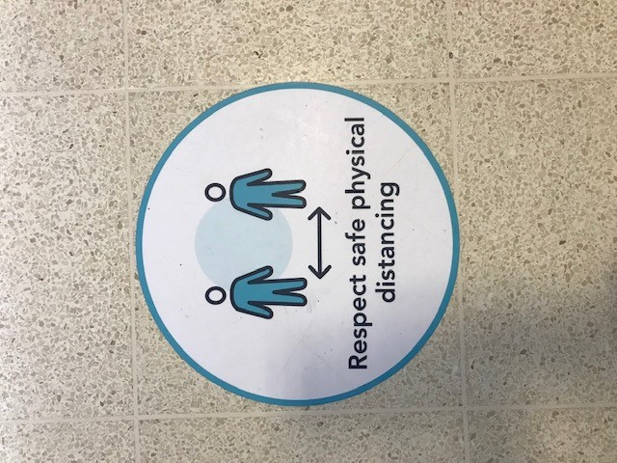
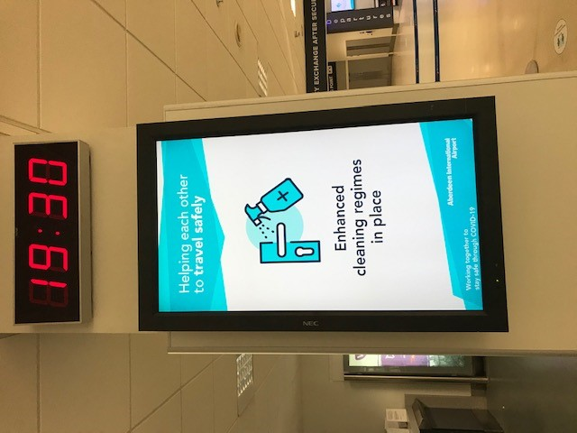
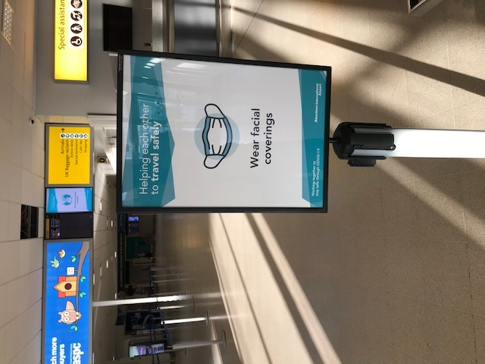
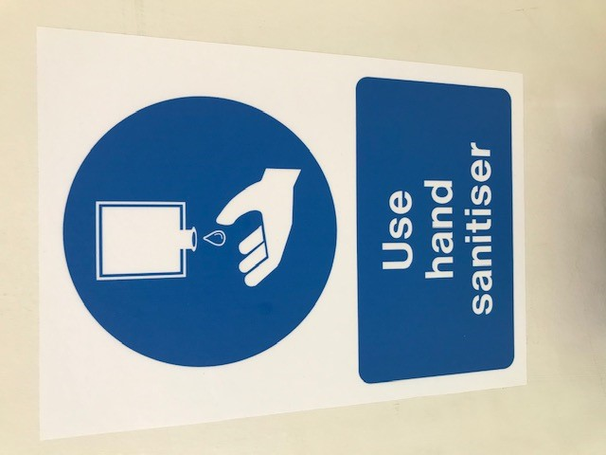
Clear Signage/Instruction throughout the Terminal building
Floor markers for physical distancing
Use of Digital screens for messaging
Loudspeaker announcement played every 30 minutes throughout the terminal reminding passengers of safety measures.

Slide 9
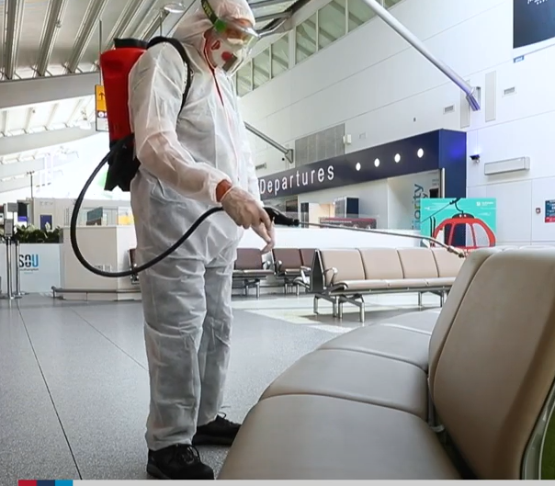
Enhanced Cleaning – Use of Anti-microbial technology
We are now using an application called Zoono which provides an antimicrobial protection that is effective against a wide range of bacteria, viruses and pathogens.
Our cleaning team have been trained to use this by use of a spray as well as wiping down surfaces.
It stays active for extended periods of time providing protection on surfaces.
The team apply the product in all areas and they start the process all over again when they are complete.

Slide 10
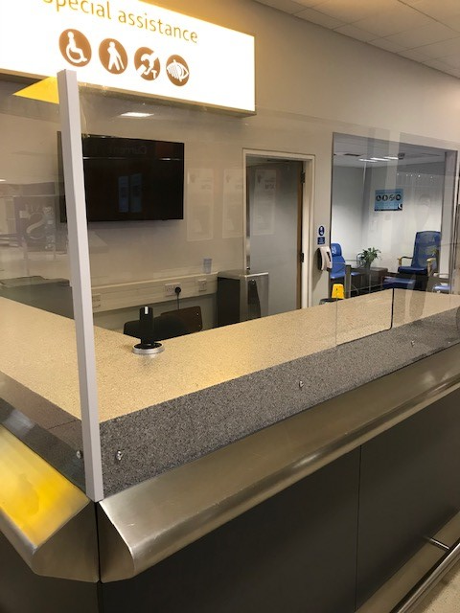
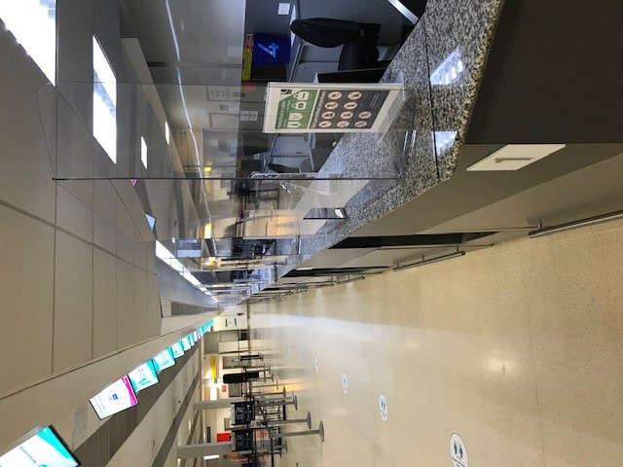
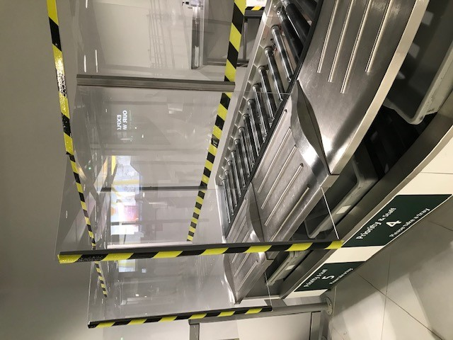
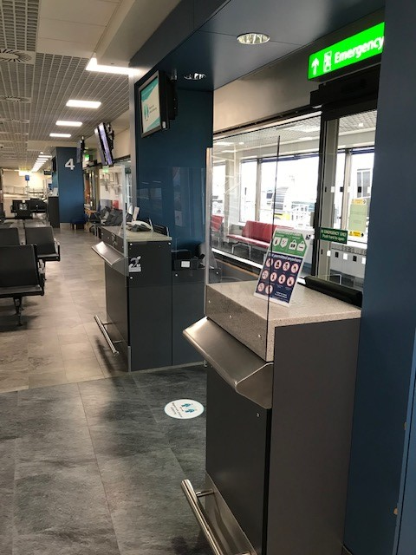
Perspex screens at all customer interface points
Assistance Desk
Check In
Security Search
Departure Gates
The clear Perspex screens provide protection against the spread of the virus for our staff and for passengers.

Slide 11
Control of Passenger Flow
To help with physical distancing we have introduced a one way system at the main entrance/exit of the building.
We have also created a divide on the corridor leading to and from the UK baggage reclaim area.
We have allowed for space between flights checking in and we have an increased presence near the front of the terminal to assist with passenger enquiries and manage any queues.

Slide 12
Website improvements and specific section on Covid-19
We are giving passengers the option to pre-register before travelling. This allows the airport to provide coronavirus information and travel guidelines relevant to the journey.
Similarly we can then guide passengers through the new airport experience and keep them updated with the latest information.
A short video has been produced by AGS Airports to explain the new measures that are in place and this is available on the website.
We have a section of the website dedicated to Covid-19 matters (www.aberdeenairport.com/coronavirus) and have also updated our Special Assistance pages with additional information.
We have been able to answer many questions/queries throughout the lockdown period through our text feedback service and social media channels.

Slide 13
Face Coverings and Exemptions
Under Scottish Government legislation face coverings are required to be worn in the Terminal Building and on flights.
However, we understand some people are exempt from this requirement.
To help with this we are able to supply any passenger with a face covering exempt card that can be attached to a lanyard. Our team will also recognise other cards/means of highlighting an exemption.
As per the picture we now are using the Sunflower Lanyard which brings us in line with the majority of airports and various other places throughout the UK, simplifying the process for passengers with hidden disabilities.

Slide 14
Face Coverings/Face shields
We expect our team members to politely remind anyone not wearing a face covering of the requirement to do so.
Equally our teams have been fully briefed that there are a variety of reasons why someone might not be able to wear a face covering.
If a passenger relies on lip reading or needs any member of staff to remove their face covering temporarily to help communicate then they just need to let them know.
Scottish Government guidance on Face shields : they may be used, but only if they are worn in addition to a face covering underneath, as the evidence shows that they do not provide adequate protection.
If a passenger is unable to wear a face covering, a face visor or face shield can be worn as it does provide a limited level of protection.

Slide 15
Live Transcribe app to improve communication
Based on feedback we have installed the Live Transcribe app on all of the devices used by the Assistance team.
Live Transcribe provides real time, speech to text transcriptions to make conversations more accessible for deaf and hard of hearing passengers.

Slide 16
NHS Patient Lounge
We have converted one half of the former Eastern Airways lounge (situated on the Northern Walkway near gates 7-12) into the NHS Patient Lounge.
This is a dedicated area for patients and their carers/families travelling to/from hospital. It is a quiet area with comfortable seating and is situated close to the departure gates used for the flights to the Northern Isles.

Slide 17
Current Flight Schedule
Loganair flights to Sumburgh, Kirkwall, Norwich, Manchester, Bristol, Birmingham, Esbjerg, Belfast City, Newcastle, Southampton and Newquay
Eastern Airways to Humberside and Teeside
Wideroe to Bergen and Stavanger
SAS to Stavanger
KLM to Amsterdam
British Airways to London Heathrow
Easyjet to London Luton
Wizz Air to Gdansk
Ryanair to Alicante, Malaga and Faro
Notes:
April to September – struggled to meet passengers within 5 and 10 minute SLA’s for both pre-booked and non pre-booked

Slide 18
Flight Schedule
In September Air France have resumed flights to Paris (3 a week initially) and KLM have increased to 4 daily flights.
However, the ongoing pandemic is having a major impact on passenger numbers and reduced flight schedules.
The local Aberdeen lockdown also had an adverse impact on passenger numbers and confidence to travel.
TUI cancelled their summer 2020 programme.
Specifically blanket quarantine measures which are changing on a weekly basis are having a debilitating effect on passenger numbers. AGS Airports fully support the introduction of testing at airports as an alternative to blanket quarantine measures to give passengers the confidence to travel again.

Slide 19
Retail
World Duty Free and Boots reopened their stores on Monday 20th July. WH Smiths reopened one of their airside stores on Thursday 23rd July.
The Distilling House (bar and restaurant) reopened on Thursday 30th July. During the local Aberdeen lockdown it has remained open as a takeaway.
The Northern Lights Lounge reopened on 1st August but had to close on 5th August when the local Aberdeen lockdown was announced. A re-opening date has still to be announced.
The Granite City, Bocco and Joe’s Coffeehouse remain closed.
Rolling Luggage will not be reopening.
We are awaiting further updates regarding the Travelex store.

Slide 20
Access Forum involvement
Equality Impact Assessment
Given that we have introduced various travel safety measures in the terminal we are keen to complete an impact assessment. We would welcome your input and involvement. We would be seeking two or three representatives from the forum to help complete this.
Video call
We would like to gauge whether forum members would welcome a video call for the next update on Microsoft Teams? Please let us know.
Feedback and questions
As always we welcome your comments and observations.

Slide 21








4. Members Update & Discussion

